Slide 1
Udacity Connect Session
April 14, 2018
Reinforcement Learning
github.com/zkhundkar/ConnectIntensive/08..

Slide 2
Welcome back!

Slide 3
Morning Schedule
10:00 - 10:30 | Housekeeping and Review
10:30 - 11:00 | Introduction to RL
11:00 - 11:30 | Notebook Session - Tic tac toe
11:30 - noon | Notebook Review
© 2016 Udacity. All rights reserved.

Slide 4
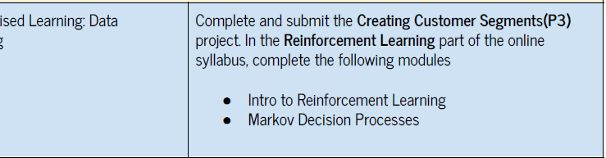
Reinforcement Learning

Slide 5
Review
CLUSTERING REVIEW
System gets unlabeled data and tries to group (cluster) them in some way - Similar vs. dissimilar (distance)
- Goal is to discover hidden “structure”
- “Hard” vs. “soft” clusters
© 2016 Udacity. All rights reserved.

Slide 6
Reinforcement Learning
OUTLINE
Define the problem
RL Framework and Terminology
Describe some solutions
- First, intuitively
- Second, more formally

Slide 7
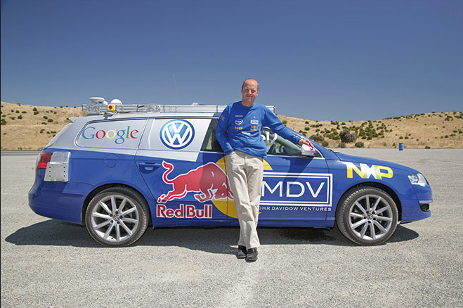
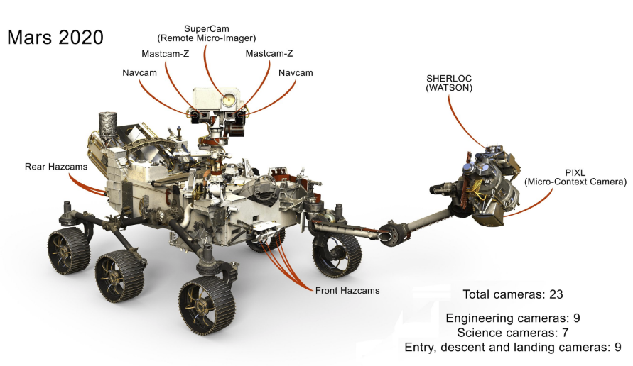
Intelligent Agents

Slide 8
Berkeley Robotic Arm Demo
https://youtu.be/JeVppkoloXs

Slide 9
Intelligent Agents
FORMULATE THE PROBLEM
WHAT ?
WHAT IS AN INTELLIGENT AGENT?

Slide 10
Terminology
DEFINITIONS
AGENT
ENVIRONMENT
GOAL

Slide 11
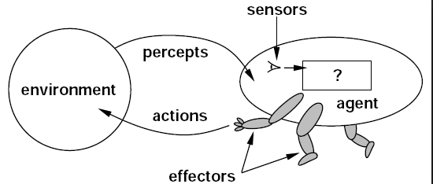
Intelligent Agent - bare essentials

Slide 12
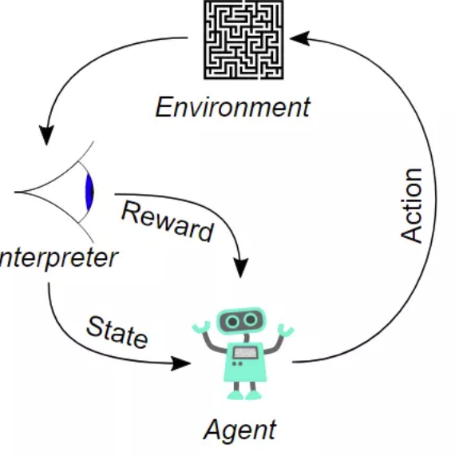
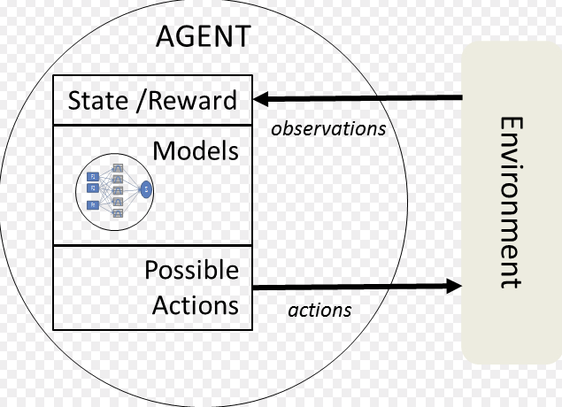
Intelligent Agents - Minimalist

Slide 13
Terminology
DEFINITIONS
STATES
ACTIONS
REWARDS

Slide 14
States
- Start (initial) state
- Goal (doesn’t have to have a goal state)
- everything else
Must maintain all information about the “world” that can affect the actions the agent might take

Slide 15
Goal - Reward Hypothesis
An RL agent’s goal can be cast as maximizing expected cumulative reward
Maximize (not less than any other “path”)
Expected (in a statistical sense)
Cumulative (total all rewards in the “future”)
Reward ???

Slide 16
Reward
Provide feedback to the agent
“Good job!”
“No, no, no!”
“No comment”
Agent uses this to figure out “appropriate” movements.

Slide 17
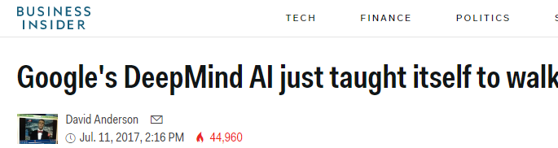
Google DeepMind Robot Walk
https://www.youtube.com/watch?v=gn4nRCC9TwQ

Slide 18
DeepMind Robot
States
Actions
Rewards
Positions and velocities of the joints
Terrain, foot and sensor data
Forces applied to each joint
Forward velocity, excessive torque, sideways motion,

Slide 19
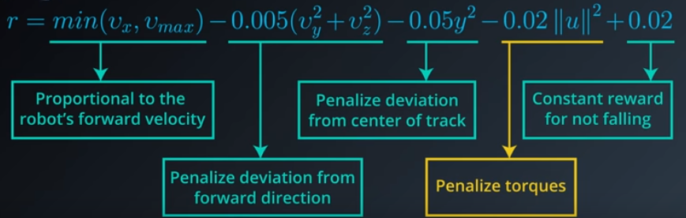
DeepMind Robot - Reward Function

Slide 20
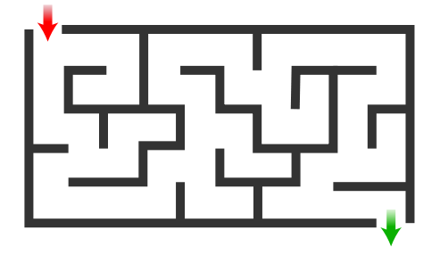
Rewards - simple quiz
GOAL - ESCAPE MAZE AS QUICKLY AS POSSIBLE
 | In Maze | Exit
a) | +1 | 0
b) | -1 | 0
c) | +1 | 10
d) | -1 | 1

Slide 21
Cumulative Reward
t₀, t₁, .., t_{i-1}, t_{i}, t_{i+1}, t_{i+2}, t_{i+3}, … t_{n}
S₀, S₁, .., S_{i-1}, S_{i}, S_{i+1}, S_{i+2}, S_{i+3}, … S_{n}
a₀, a₁, .., a_{i-1}, a_{i}, a_{i+1}, a_{i+2}, a_{i+3}, … a_{n}
R₀, R₁, .., R_{i-1}, R_{i}, R_{i+1}, R_{i+2}, R_{i+3}, … R_{n}

Slide 22
Cumulative Reward
DEFINITION OF RETURN
Return - sum of all rewards from the next time step forward
G_{i} = R_{i} + R_{i+1} + R_{i+2} + …. + R_{n}
Reward hypothesis -- choose a_{i} to maximize (E[G_{i}])
Notes:
Cannot keep track of all the rewards
Infinite problem is not possible with the above equation

Slide 23
Discounted Cumulative Reward
DEFINITION OF RETURN
Return - sum of all rewards from the next time step forward (conceptually same as Utility)
G_{i} = 𝛾⁰R_{i} + 𝛾¹R_{i+1} + 𝛾²R_{i+2} + …. + 𝛾^{n-i}R_{n}
𝛾 -- discount rate

Slide 24
github.com/zkhundkar/ConnectIntensive/
08a RL Intro

Slide 25
Lunch Break

Slide 26
Afternoon Session
1:00 - 1:30 | Markov Decision Process
1:30 - 2:00 | Solving MDPs
2:00 - 2:30 | State Value functions/Optimal Policy
2:30 - 3:00 | Recap, Lookahead and Feedback
3:00 - 5:00 | Work on P3
© 2016 Udacity. All rights reserved.

Slide 27
Grid World - Deterministic
ACTIONS - U (UP), D (DOWN), L (LEFT) R (RIGHT)
 | 1 | 2 | 3 | 4
c
b
a | X

Slide 28
Grid World - Stochastic
ACTIONS - U (UP), D (DOWN), L (LEFT) R (RIGHT)
Action moves you in the “expected” direction with prob = 0.8
perpendicular direction (either side) with prob 0.1
 | 1 | 2 | 3 | 4
c
b
a | X |  |  | X

Slide 29
MDP - Graph Model
GRID WORLD
U, p=0.8, r=-0.04
L, p=0.1, r=-0.04
R, p=0.8,
r = + 1.0
a,1
b,1
c,1
c,2
c,3
c,4
D, p=0.1, r=-0.04
R, p=0.8, r=-0.04
b,3
b,4
a,2
a,3
a,4

Slide 30
Representing a stochastic world
MARKOV DECISION PROCESS
States {s_{i}}, i < N
Actions {a_{i}} a ∼ A(s) ∼ A
Model T(s₁, s₂, … , s_{i}, a, s_{i+1}) ∼ P(s_{i+1} | s₀, s₁, s₂, … s_{i}, a)
Markov assumption T(s_{i}, a, s_{i+1}) ∼ P(s_{i+1} | a, s_{i})
Reward {r_{i}}

Slide 31
Solution
Given a MDP
Given an initial state
Using the reward hypothesis
Select a series of actions that will maximize the return

Slide 32
Policy
Deterministic 𝜋 : S → A
Stochastic 𝜋 : S x A → [0,1]

Slide 33
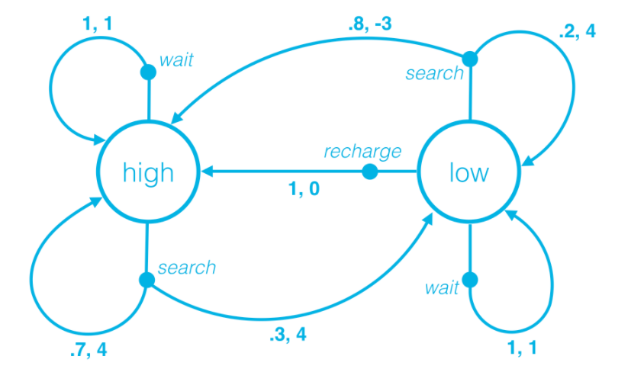
Policy - quick check
π(high) = search
π(low) = recharge
π(search|high) = 0.9
π(wait|high) = 0.1
π(wait|low) = 0.4
π(search|low) = 0.1
π(recharge|low) = 0.5

Slide 34
State Value Function
ACTIONS - {U, D, L R} R - {-0.1 (W), -0.3 (GRAY)
V_{𝜋}(s) = sum of all cumulative rewards
𝜋(a,2) = (L, L, U, R, R, U, R)
 | 1 | 2 | 3 | 4
c |  |  | 1.0 | +1.0
b | 0.5 | 0.6 | 0.9 | -1.0
a | 0.4 | X | 0.8

Slide 35
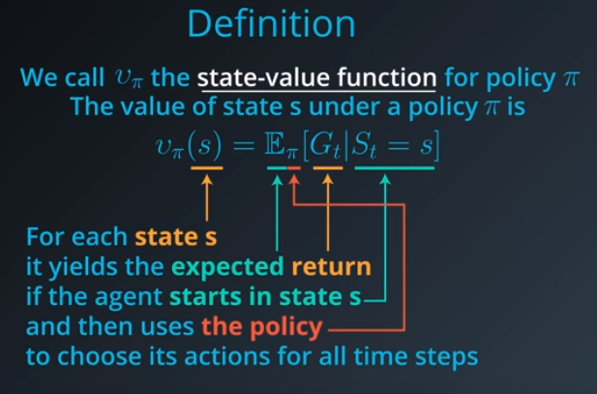
State Value Function

Slide 36


Bellman Equation
PART ONE - STATE VALUE
Deterministic
Stochastic (with uncertainty of outcome)

Slide 37
Optimal Policy
DEFINITIONS
Policy 𝜋’ is better than policy 𝜋 if the following is true:
V_{𝜋’} (s) ≥ V_{𝜋}(s) for all states s ∊ S
There is at least one policy which is “better” than every other
Optimal policy is denoted as 𝜋* by convention (may not be unique)
Solution of the MDP
Optimal state-value function is v*(s) (by convention)

Slide 38
Action-value Function
V_{𝜋}(s) = E_{𝜋}[G_{t}|S_{t}=s]
q_{𝜋}(s,a) = E_{𝜋}[G_{t}|S_{t}=s, a_{t}=a]
For each state s,
Expected return
If agent starts in state s
Uses the policy 𝜋
To choose actions for all time steps
For each state s and action a,
Expected return
If agent starts in state s
then chooses action a
And Uses the policy 𝜋
To choose actions for all time steps

Slide 39
Action Value Function
ACTIONS - {U, D, L R} R - {-0.1 (W), -0.3 (GRAY)
 | 1 | 2 | 3 | 4
c |  |  |  | +1.0
b |  |  |  | -1.0
a |  | X | 0.8

Slide 40
Action Value Function
ACTIONS - {U, D, L R} R - {-0.1 (W), -0.3 (GRAY)
 |  |  | +1.0
 |  |  | -1.0
 |  | 0.8
0
0
0
0
0
0
0
0
0
0
0
0
0
0
0
0
0
0
0
0
0
0
0
0

Slide 41
Prep for next week
Complete Customer segments Project (P3) this week!!
Reinforcement Learning - Lessons 1 - 5

Slide 42
Reinforcement Learning

Slide 43
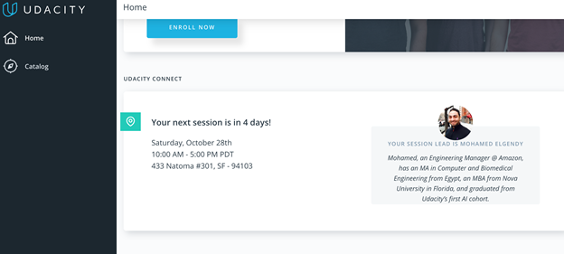
We really need your Feedback!
© 2016 Udacity. All rights reserved.

